Slide 1
Linked-Lists
Slides by Varick and Ashley Erickson
© Varick and Ashley Erickson

Slide 2
Why linked lists
Linked lists can help us do more stuff with data!
We can insert stuff into the middle of a list
We can delete stuff from the middle of a list
We can easily add stuff to the front or back of a list
Linked lists live in dynamic memory, so the size can be easily adjusted

Slide 3
Where linked lists are more efficient
Linked lists are very useful when…
you want to insert items at the beginning or middle of your list.
Your data needs to be able to easily grow and shrink as needed
You want to use dynamic memory
Linked lists are not very useful when…
You need to access a particular element or “index” (linked lists are not efficient for this – we have to read through the whole list!)
Link lists are not very good at searching (even if they are sorted)

Slide 4

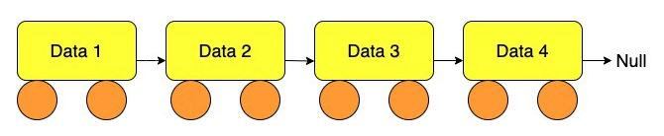
Linked list organization
Data 1
Data 2
Data 3
Data 4
head
null
list
head
Node 1
Node 2
Node 3
A Linked list contains 0 or more nodes:
The linked list’s head to point to first node
Last node points to null(address 0)

Slide 5
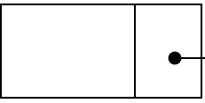
Review: The arrow operator ->
The arrow operator combines the actions of the dereferencing operator (*) and the dot operator (. ) .
head->data = 23;
head->next = NULL
The arrow operator is the same as writing
(*head).data = 23;
(*head).next = NULL;
head
data
*next
23
NULL

Slide 6
Node organization
In C++, nodes are implemented as structs or classes
A node contains:
data: one or more data fields – may be organized as structure, object, etc.
a pointer (often called “next”) that can point to another node
struct ListNode
{
int data;
ListNode *next;
};
next
data

Slide 7
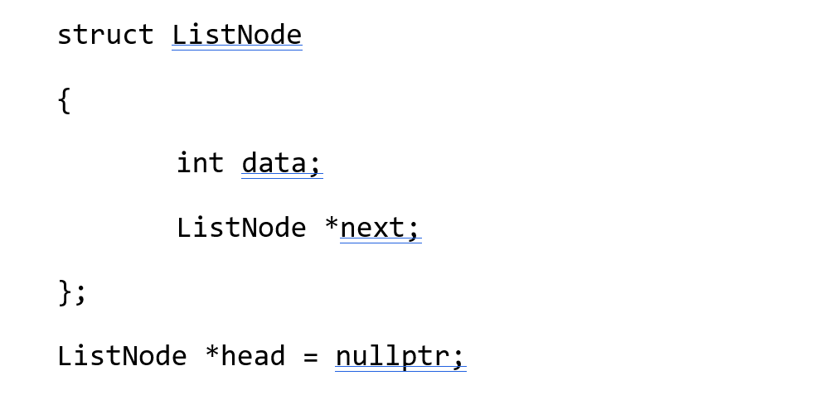
Memory Diagram Practice
Draw what the code produces and explain your answer:

Slide 8
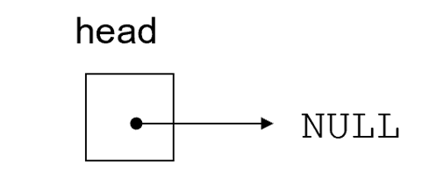
Memory Diagram Practice
Suppose we have the following:
Then the following code is run:
head = new ListNode;
head->data = 12;
head->next = nullptr;

Slide 9
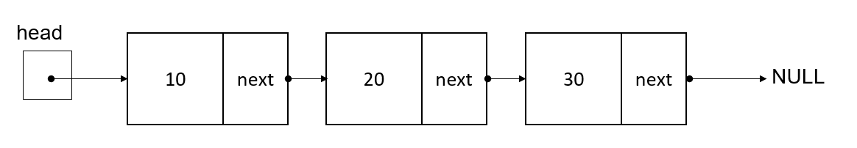
Memory Diagram Practice
Suppose we have the following:
Then, we run the following lines of code.
ListNode* nextNode;
nextNode = new ListNode;
nextNode->data = 99;
nextNode->next = nullptr;
head->next->next->next = nextNode;
cout << head->next->next->next->data;

Slide 10
Memory Diagram Practice
We have this linked list of the type ListNode as shown here
Write the code which will add a node containing the number 99 to the end of the list

Slide 11
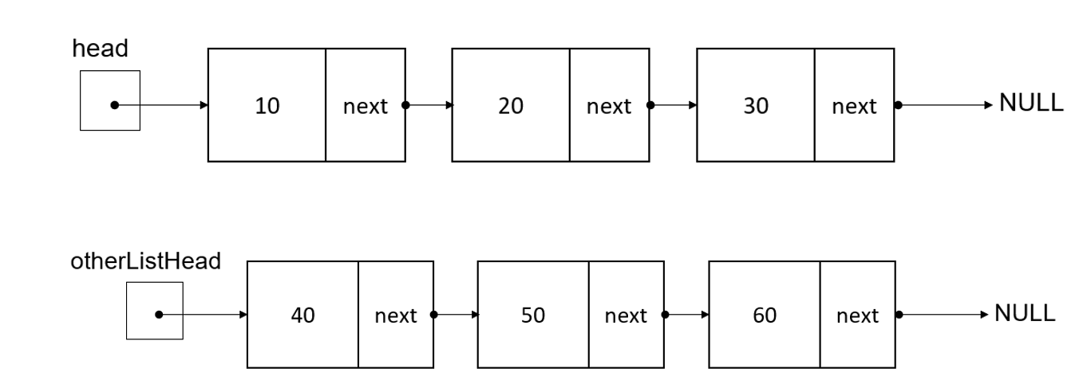
Memory Diagram Practice
Suppose we have the two linked lists shown below.
Write the code which will attach the lists together like below?

Slide 12
Example: Inserting nodes
Suppose we have these two nodes. We want to insert the head linked list into otherListHead’s linked list, between nodes 40 and 50.
Let’s look at this step by step.
insert

Slide 13
Example: Inserting nodes
Identify the location where you want to insert the new nodes
Connect the pointer from the new node to the list to create a link. What code should we write to do this?
Insert here
Stuff we want to insert

Slide 14
Example: Inserting nodes
2. Connect the pointer from the new node to the list to create a link.
head->next->next->next = otherListHead->next;
//makes pointer at head’s 3rd node point to the insertion point
//(the location which otherListHead->next points at)

Slide 15
Example: Inserting nodes
Now we need to connect otherListHead’s first node to the first node of head:
What code should we write to connect otherListHead’s node to head?

Slide 16
Example: Inserting nodes
Now we need to connect otherListHead’s first node to the first node of head:
Connect otherListHead to head:
otherListHead->next = head;
//makes otherListHead’s first node point to the first node of the
//nodes to insert

Slide 17
Example: Inserting nodes
We now have the below inserted linked list!
4. Now we need to update the head pointer, since the head pointer has changed from head to otherListHead. What code should we write?

Slide 18
Example: Inserting nodes
All finished!
head
head = otherListHead;
//updates the location of the head pointer to be the new
//beginning of the linked list, at otherListHead.

Slide 19
Codey sense question
We just discussed that to insert, you need to
add a link from the new node to the list, and
then add a link from the list to the new node.
What would happen if we reversed these steps like shown below?
A: Reversing the steps does not matter. We would get the same result.
B: Reversing the steps will produce the same result with less code.
C: Reversing the steps will produce the same result, but with more code needed.
D: Reversing the steps will produce a different result. Some nodes will be orphaned and we will produce a memory leak.
1. Add link from list to new node
2. Add link from new node to list

Slide 20
Codey sense question
Reversing the steps will produce a different result. Some nodes will be orphaned and we will produce a memory leak.
Add a link from list to new node
2. Add a link from new node back to the list
These nodes become orphaned because we just disconnected from them from their head node!!! There is nothing storing the memory address of node 50.
There is nothing left to connect back to, because we lost the memory address of these nodes!

Slide 21
Key takeaway: inserting nodes
To insert, you need to
add a link from the new node to the list, and
then add a link from the list to the new node.
CAUTION!!!! when changing the pointers, be careful not to “orphan” any nodes or lose the head! Be sure to maintain some connection to your head and all nodes at all times. Otherwise, your program will create memory leaks and lost nodes.

Slide 22
Stepping through a linked list
Recall, the -> operator allows us to step through a linked list.
If next is the name of our pointer, we can use ->next to advance to the next item.
Examples:
cout << head->data; // returns 10
cout << head->next->data; // returns 20
cout << head->next->next->next; // returns NULL
cout << head->next->next->next->data; // returns nullpointer exception
head = head->next // makes head pointer point to the
// next item in the list

Slide 23
Quick question
Suppose we have the below linked list, with myPointer pointing to the second node. Which of the following lines of code will advance the pointer “myPointer” to the next node?
A: myPointer->next;
B: myPointer = next;
C: myPointer = next+1;
D: myPointer++;
E: myPointer = myPointer->next;
myPointer

Slide 24
Things to be aware of when stepping
You can only travel one direction in a (singly) linked list. You cannot use -> next to go backwards.
There are special types of linked lists (doubly linked lists) where you have two pointers per node, allowing travel in both directions.
Our book likes to name the linked list pointers “link” but programmers also commonly name the pointers “next”.

Slide 25
Questions before we continue?
Next: how to search in a linked list

Slide 26
How to search in a linked list: pseudocode
Declare a pointer (“curr”) to point to a node type struct.
Set curr to point to the head initially
Check whether the node curr is pointing to contains the desired value
If the curr pointer’s points at the desired value, return the pointer curr.
If not, move to the next node of the linked list (curr = curr->next)
Otherwise, if we search all the way until we reach null, the desired value must not be present in the Linked List.

Slide 27
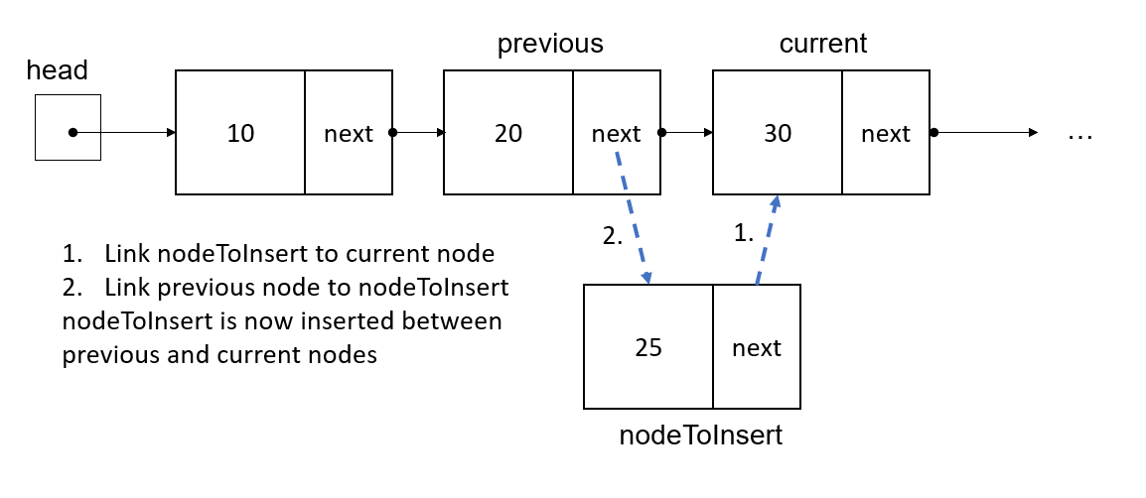
Searching and inserting
If you need to search and then insert something into a linked list, you should declare two pointers to help you search.
One pointer to point at the current location
One pointer to point at the previous location
Declare pointers to point at the current and previous node.

Slide 28
Searching and inserting
You can use a while loop to step through the linked list until the current and previous pointers find the desired location.
Then, you can use current and previous pointers to help insert the node you want to insert:
ListNode* prev = nullptr;
ListNode* curr = head;
while (curr != nullptr)
{
if (curr->data == desiredValue)
break;
prev = curr;
curr = curr->next;
}
nodeToInsert->next = current;
prev->next = nodeToInsert;

Slide 29
Another Codey Sense question
Which of the following statements about these loops is true?
A
B
ListNode* prev = nullptr;
ListNode* curr = head;
while (curr != nullptr)
{
if (curr->data == desiredValue)
break;
prev = curr; curr = curr->next;
}
nodeToInsert->next = current;
prev->next = nodeToInsert;
ListNode* prev = nullptr;
ListNode* curr = head;
while (curr->data != desiredValue)
{
prev = curr;
curr = curr->next;
}
nodeToInsert->next = current;
prev->next = nodeToInsert;
A: Loop A is less efficient since it requires more code
B: Loop B could create an infinite loop
C: Loop B could cause a runtime exception if the desired value is not present in the list
D: Both of these loops are equivalent

Slide 30
Any questions before we continue?
Next topic: linked list good practices
Searching a linked list

Slide 31
Linked List good practices
Make sure you check for an empty list before manipulating it.
You should always keep one pointer variable pointing to the head of the linked list. This pointer can be used as the linked list argument in functions and to help you access the data.
Be careful not to lose your head node. If you overwrite your pointer which points to the head node, you can lose your ability to access that node. You could lose your ability to access your memory, and also tie up memory that cannot be used for other parts of your program.

Slide 32
Linked List Operations to know
Basic operations:
append a node to the end of the list
insert a node within the list
traverse the linked list
delete a node
delete/destroy the list

Slide 33
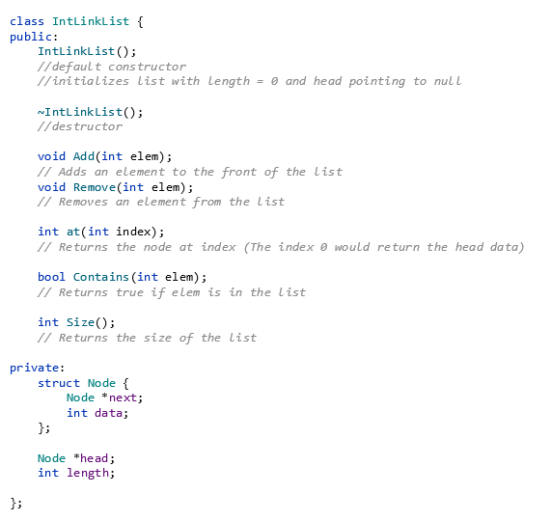
Making constructors
Recall, you can use a class to make nodes for a linked list or other data structure
You can declare constructors to initialize objects for nodes.
It’s a good idea to initialize pointers to NULL initially and initialize data in your object to a known value

Slide 34
Example: Constructor for IntLinkList class:
Sample default constructor definition: make IntLinkList object’s head pointer point to null and set length to zero to create an empty list.
IntLinkList::IntLinkList()
{
// Set up the list
head = nullptr;
length = 0;
}

Slide 35
Deleting items and Destructors
Destructors are special member functions used to delete objects from a class.
You put a ~ in front of the class name to create a destructor.

Slide 36
Deleting items and Destructors
Destructors allow us to delete linked lists and nodes when we are finished.
If we do not delete our linked lists, we could run out of memory and cause our computer to crash.
It’s a good practice to always include destructors when using linked lists so that you can clean up your memory when you are finished using it.

Slide 37

One way to define a destructor
You can also make a destructor using a loop to delete the items in the linked list.
This code will read each item of the linked list, starting with the head and ending with null. This code changes head to be the next value in the list, and then deletes the current value.
Once we reach null, all nodes will be deleted.
MyLinkedList::~MyLinkedList()
{
while (head != nullptr)
{
Node* oldHead = head;
head = head->next;
delete oldHead;
}
}

Slide 38
Example: Destructor for IntLinkList class:
Sample destructor definition
// Destructor
IntLinkList::~IntLinkList()
{
Node* oldHead;
while (head != nullptr) // Don't need to delete things if the head is null
{
oldHead = head;// Remember the original head
head = head->next;// Advance the head
delete oldHead;// Delete the old head
}
}

Slide 39
Important notes about destructors
Destructors must be declared and defined by the programmer in order to actually delete nodes.
Like the default constructor, the compiler will automatically create a destructor for you if you forget, but the destructor will be empty. It will not do anything unless we define it.

Slide 40
FYI: copy constructors
When you pass a linked list object into a function, it is passed by value. This can be a problem when we are passing memory addresses.
A copy constructor is used to make a deep copy is a copy of a linked list at an entirely new memory address. This helps prevent the linked list and its copy from sharing data at the same memory address.

Slide 41
Example: Write the Add function to add a node to the front of the list
class IntLinkList
{
public:
IntLinkList();
~IntLinkList();
void Add(int elem);// Adds an element to the front of the list
void Remove(int elem);// Removes an element from the list
int at(int index);// Returns the node at index
bool Contains(int elem);// Returns true if elem is in the list
int Size();// Returns the size of the list
private:
struct Node
{
Node* next;
int data;
};
Node* head;
int length;
};
void IntLinkList::Add(int elem)
{
// add code here
}

Slide 42
Example: Solution: Write the Add function to add a node to the front of the list
class IntLinkList
{
public:
IntLinkList();
~IntLinkList();
void Add(int elem);// Adds an element to the front of the list
void Remove(int elem);// Removes an element from the list
int at(int index);// Returns the node at index (The index 0 would return the head data)
bool Contains(int elem);// Returns true if elem is in the list
int Size();// Returns the size of the list
private:
struct Node
{
Node* next;
int data;
};
Node* head;
int length;
};
void IntLinkList::Add(int elem)
{
// Make and initialize a new node
Node* node = new Node;
node->next = nullptr;// Good practice to immediately initialize
node->data = elem;
// Add the new node to front
node->next = head;
head = node;// Node is now the head
// Book keeping... list size increased by one
length++;
}

Slide 43
Example: Write the Contains function to check whether list contains elem
class IntLinkList
{
public:
IntLinkList();
~IntLinkList();
void Add(int elem);// Adds an element to the front of the list
void Remove(int elem);// Removes an element from the list
int at(int index);// Returns the node at index
bool Contains(int elem);// Returns true if elem is in the list
int Size();// Returns the size of the list
private:
struct Node
{
Node* next;
int data;
};
Node* head;
int length;
};
bool IntLinkList::Contains(int elem)
{
// add code here
}

Slide 44
Example: Solution: Write the Contains function to check whether list contains elem
class IntLinkList
{
public:
IntLinkList();
~IntLinkList();
void Add(int elem);// Adds an element to the front of the list
void Remove(int elem);// Removes an element from the list
int at(int index);// Returns the node at index
bool Contains(int elem);// Returns true if elem is in the list
int Size();// Returns the size of the list
private:
struct Node
{
Node* next;
int data;
};
Node* head;
int length;
};
bool IntLinkList::Contains(int elem)
{
// Start search at the head and return true if we find it
Node* curr = head;
while (curr != nullptr)
{
if (curr->data == elem)
return true;
curr = curr->next;
}
// Return false if we go through the entire list
// and don't find it
return false;
}

Slide 45
The Remove function
void IntLinkList::Remove(int elem)
{
// Don't do anything if the list is empty
if (head == nullptr)
return;
Node* prev = nullptr;// no previous initially
Node* curr = head;
bool found = false;// flag to see if we found it
while (curr != nullptr)
{
// if we find the element...
if (curr->data == elem)
{
found = true;
break;
}
prev = curr;// Update previous
curr = curr->next;// Advance curr
}
// Didn't find it... return out
if (!found)
return;
// What if the node we are trying to delete is the head?
if (curr == head)
{
head = head->next;// Advance the head
delete curr;
}
else
{
// General remove case
prev->next = curr->next;
delete curr;
}
// Book keeping...
length--;
}
The Remove function removes the node which contains elem.
We need code to account for multiple cases:
If the list is empty, do nothing
If the node to remove is in the middle or end of the list, remove it and update pointers to point at next node
If the node to remove is in the very beginning of the list, move head pointer to the second node and delete the first node
If the item cannot be found in the list, use return to go back to main without removing anything

Slide 46
Demo: running IntLinkList class

Slide 47
Demo: Linked List example
class IntLinkList
{
public:
IntLinkList();
~IntLinkList();
void Add(int elem);// Adds an element to the front of the list
void Remove(int elem);// Removes an element from the list
int at(int index);// Returns the node at index (The index 0 would return the head data)
bool Contains(int elem);// Returns true if elem is in the list
int Size();// Returns the size of the list
private:
struct Node
{
Node* next;
int data;
};
Node* head;
int length;
};
Header file IntLinkList.h

Slide 48
Linked list example
#include "IntLinkList.h"
#pragma once
#include "IntLinkList.h"
#include <stdlib.h>
IntLinkList::IntLinkList()
{
// Set up the list
head = nullptr;
length = 0;
}
// Destructor
IntLinkList::~IntLinkList()
{
Node* oldHead;
while (head != nullptr) // Don't need to delete things if the head is null
{
oldHead = head;// Remember the original head
head = head->next;// Advance the head
delete oldHead;// Delete the old head
}
}
void IntLinkList::Add(int elem)
{
// Make and initialize a new node
Node* node = new Node;
node->next = nullptr;// Good practice to immediately initialize
node->data = elem;
// Add the new node to front
node->next = head;
head = node;// Node is now the head
// Book keeping... list size increased by one
length++;
}
void IntLinkList::Remove(int elem)
{
// Don't do anything if the list is empty
if (head == nullptr)
return;
Node* prev = nullptr;// no previous initially
Node* curr = head;
bool found = false;// flag to see if we found it
while (curr != nullptr)
{
// if we find the element...
if (curr->data == elem)
{
found = true;
break;
}
prev = curr;// Update previous
curr = curr->next;// Advance curr
}
// Didn't find it... return out
if (!found)
return;
// What if the node we are trying to delete is the head?
if (curr == head)
{
head = head->next;// Advance the head
delete curr;
}
else
{
// General remove case
prev->next = curr->next;
delete curr;
}
// Book keeping...
length--;
}
int IntLinkList::at(int index)
{
// Check to see if we are within bounds
if (index > length || index < 0)
exit(0);
// Hop "index" times down the list
Node* curr = head;
for (int i = 0; i < index; i++)
curr = curr->next;
// Return the value at the index
return curr->data;
}
bool IntLinkList::Contains(int elem)
{
// Start search at the head and return true if we find it
Node* curr = head;
while (curr != nullptr)
{
if (curr->data == elem)
return true;
curr = curr->next;
}
// Return false if we go through the entire list
// and don't find it
return false;
}
int IntLinkList::Size()
{
return length;
}
Implementation file IntLinkList.cpp

Slide 49
Linked List example
// ConsoleApplication3.cpp : This file contains the 'main' function. Program execution begins and ends there.
//
#include "IntLinkList.h"
#include <iostream>
using namespace std;
int main()
{
IntLinkList list;
cout << "---------------- Adding Stuff -----------------" << endl;
for (int i = 0; i < 10; i++)
list.Add(i * 2);
for (int i = 0; i < list.Size(); i++)
cout << "The element of the " << i << "th node is " << list.at(i) << endl;
cout << "---------------- Checking Contain -----------------" << endl;
if (list.Contains(10))
cout << "The list has 10" << endl;
else
cout << "The list does NOT have 10" << endl;
cout << "---------------- Checking Remove -----------------" << endl;
cout << "Trying to remove 10" << endl;
list.Remove(10);
if (list.Contains(10))
cout << "The list has 10" << endl;
else
cout << "The list does NOT have 10" << endl;
for (int i = 0; i < list.Size(); i++)
cout << "The element of the " << i << "th node is " << list.at(i) << endl;
cout << "Trying to remove everything" << endl;
for (int i = 0; i < 10; i++)
list.Remove(i * 2);
cout << "Size of list is now " << list.Size() << endl;
}
Main function

